Slide 1

Police and Thief
ESP3201 Project
Machine Learning in Robotics
A0205393H Irwin Chin De Tao
A0199806L Jevan Goh

Slide 2
Content
Problems faced
Updated plans
Current progress
Work to be done

Slide 3
Problem faced
Mujoco is the physics engine but it uses linux or mac os
Installation of virtual machine to run ubuntu
Allocation of cpu and gpu cores
Installing and setting up of environments and dependencies

Slide 4
Timeline plan
Set up a virtual machine to run the simulation
Install the necessary dependencies
Test out the default demo simulation
Creating of a designed map

Slide 5
Virtual machine
Oracle Virtual box
Ubuntu 20.04 LTS
Xrdp (windows to communicate with ubuntu remote desktop)

Slide 6
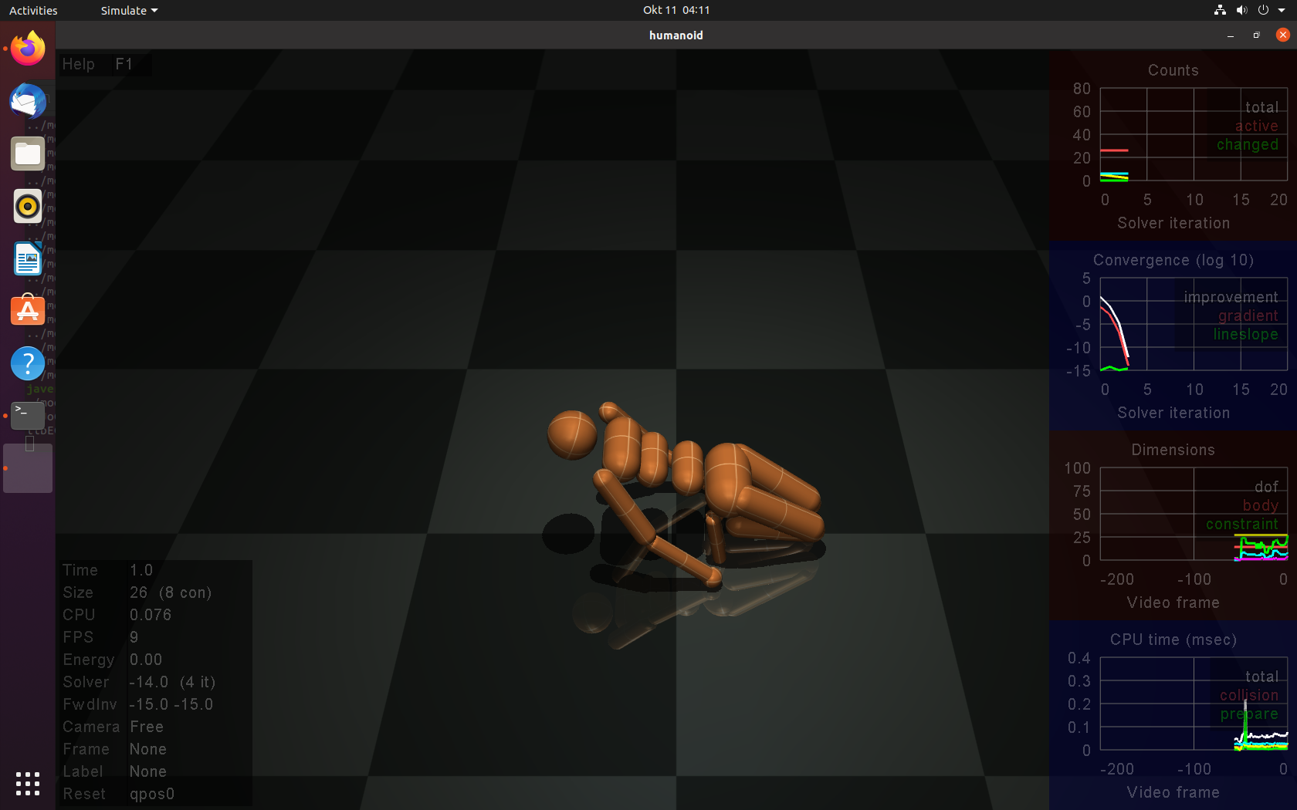
Mujoco Physics Engine

Slide 7
New Design: Locked Thief
Exit point

Slide 8
Work to be done
Get the dependencies working in the virtual machine
Test out the demo parameters
Work on 2D environment while debugging and setting up dependnecies

Slide 9
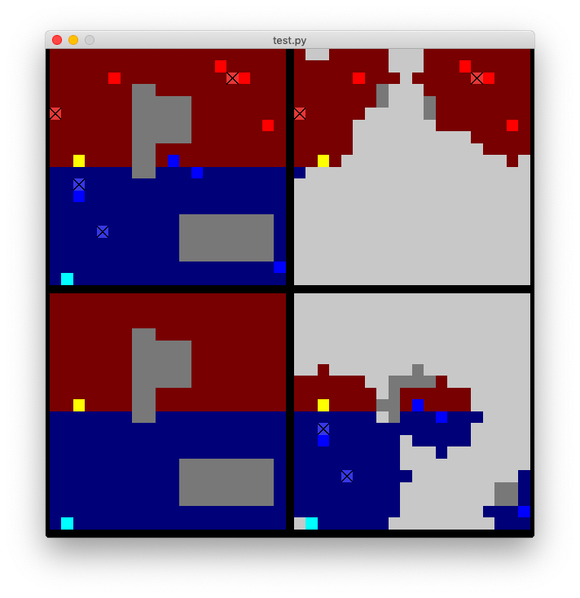
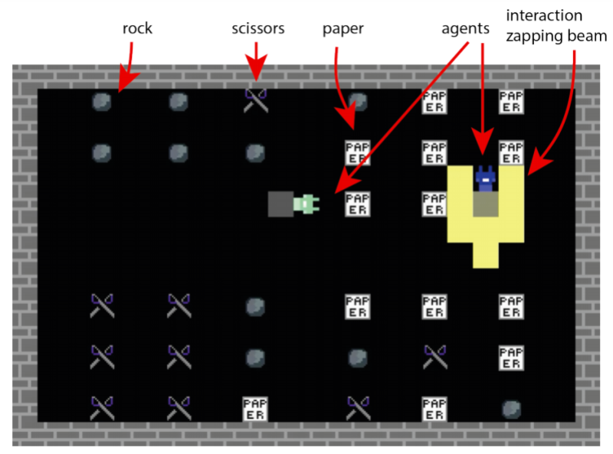
2D RL Environments
https://venturebeat.com/2020/11/16/deepmind-open-sources-lab2d-a-grid-based-environment-for-reinforcement-learning-research/
https://raide-project.github.io/ctf_research/about/

